Slide 1
Unit 2
Richard Palmer

Slide 2
# need to set this to true for ppt, but false for pdf knit_echo = TRUE # get libraries library(dplyr)
## ## Attaching package: 'dplyr'
## The following objects are masked from 'package:stats': ## ## filter, lag
## The following objects are masked from 'package:base': ## ## intersect, setdiff, setequal, union
library(ggplot2) library(plotly)
## ## Attaching package: 'plotly'
## The following object is masked from 'package:ggplot2': ## ## last_plot
## The following object is masked from 'package:stats': ## ## filter
## The following object is masked from 'package:graphics': ## ## layout
library(ggalt)
## Registered S3 methods overwritten by 'ggalt': ## method from ## grid.draw.absoluteGrob ggplot2 ## grobHeight.absoluteGrob ggplot2 ## grobWidth.absoluteGrob ggplot2 ## grobX.absoluteGrob ggplot2 ## grobY.absoluteGrob ggplot2
library(ggcorrplot) library(tidyr) # helpful function to_inches <- function(height) { vals <- unlist(strsplit(x=height,split='-')) feet <- as.numeric(vals[1]) inches <- as.numeric(vals[2]) return (12*feet + inches) } clean_pos <- function(pos) { c <- "" if (pos == "C") { c <- "Ctr" } else if (pos == "F") { c <- "For" } else if (pos == "G") { c <- "Grd" } else if ((pos == "C-F") | (pos == "F-C")) { c <- "Ctr/For" } else if ((pos == "F-G") | (pos == "G-F")) { c <- "For/Grd" } return(c) } staying_power <- function(yrs) { s <- "1" if (yrs >= 20) { s <- ">=20" } else if (yrs > 15) { s <- "15-19" } else if (yrs > 10) { s <- "10-14" } else if (yrs > 5) { s <- "5-9" } else if (yrs > 1) { s <- "2-4" } return (s) } # load data raw_ball <- read.csv(file="PlayersBBall.csv") # convert height to inches, compute years played BBall <- raw_ball %>% rowwise() %>% mutate(htc=as.character(height),height_inches=to_inches(htc)) %>% mutate(years_played = year_end - year_start + 1) %>% mutate(str_posn =clean_pos(position)) %>% mutate(sp = staying_power(years_played)) BBall$position <- as.factor(BBall$str_posn) BBall$staying <- as.factor(BBall$sp) BBall$staying <- factor(BBall$staying,levels=c("1","2-4","5-9","10-14","15-19",">=20")) # education data raw_educ <- read.csv(file="Education_Income.csv") education <- raw_educ %>% rowwise() %>% mutate(log_income = log(Income2005)) # put the education levels in ascending order education$Educ <- factor(education$Educ,levels=c("<12","12","13-15","16",">16"))

Slide 3
Question 1
Show the number of players per position
BBall %>% filter(position != '') %>% ggplot() + geom_bar(mapping=aes(x=position)) + ggtitle("Count per position")

Slide 4
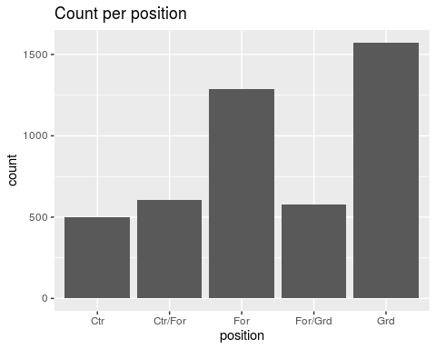

Slide 5
There are a great many more Guards and Forwards than Centers.

Slide 6
Question 2
Compare the distribution of weight of centers with that of the weight of forwards
BBall %>% filter(position == 'Ctr' | position == 'For') %>% drop_na(weight) %>% ggplot(aes(x=weight)) + geom_histogram(bins=21) + ggtitle("Distribution of Weight for Centers and Forwards") + facet_wrap(~position)

Slide 7
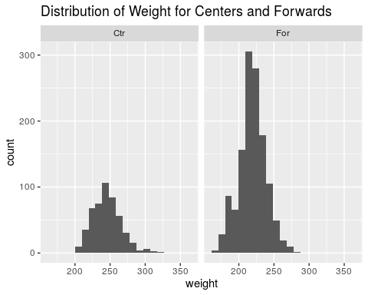

Slide 8
Centers seem to be somewhat taller than Forwards.

Slide 9
Question 3
Compare the distribution of the height of centers with that of the height of forwards
BBall %>% filter(position == 'Ctr' | position == 'For') %>% drop_na(height_inches) %>% ggplot(aes(x=height_inches)) + geom_histogram(bins=21) + ggtitle("Distribution of Height for Centers and Forwards") + facet_wrap(~position)

Slide 10
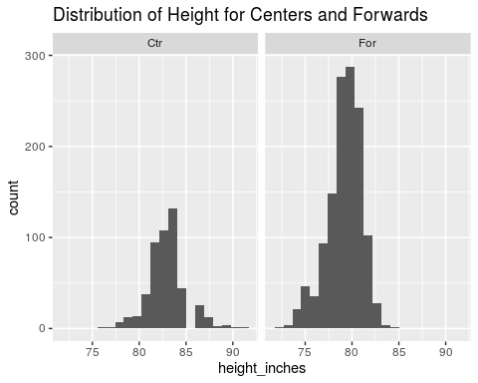

Slide 11
Centers are somewhat taller than Forwards.

Slide 12
Question 4
Investigate distribution of height across all positions
BBall %>% filter(position != "") %>% drop_na(height_inches) %>% ggplot(aes(x=height_inches)) + geom_histogram(bins=21) + ggtitle("Distribution of Height for all positions") + facet_wrap(~position)

Slide 13
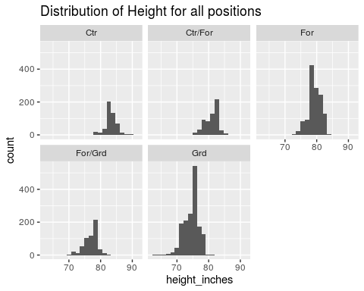

Slide 14
The distribution of height for Centers and Forwards is clearly larger than that of Guards.

Slide 15
Question 5
Investigate how a players height is related to his weight
BBall %>% drop_na(height_inches) %>% drop_na(weight) %>% ggplot(aes(x=weight,y=height_inches)) + geom_point() + ggtitle("Height versus Weight") + geom_jitter()

Slide 16
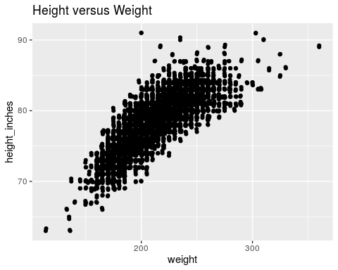

Slide 17
There is clearly a strong, apparently linear relationship between weight and height. There is more variation in weight for taller players.

Slide 18
Question 6
Is there any difference in height/weight relationship among positions?
BBall %>% drop_na(height_inches) %>% drop_na(weight) %>% ggplot(aes(x=weight,y=height_inches,color=position)) + geom_point() + ggtitle("Height versus Weight") + geom_jitter()

Slide 19
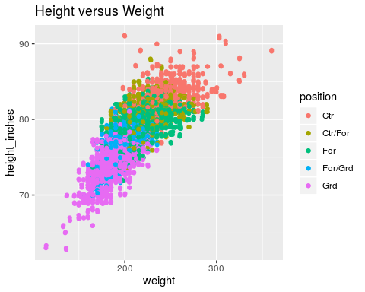

Slide 20
It is difficult to identify a different trend of height to weight by position. It might be that the slope is not so great for Centers as for Guards, but this effect might instead simply be a consequence of taller players being Centers.

Slide 21
Question 7
Is there any evidence that height has changed over the years?
BBall %>% drop_na(height_inches) %>% drop_na(year_start) %>% ggplot(aes(x=year_start,y=height_inches)) + geom_point() + ggtitle("Height versus starting year") + geom_jitter() + geom_smooth(method="lm")

Slide 22
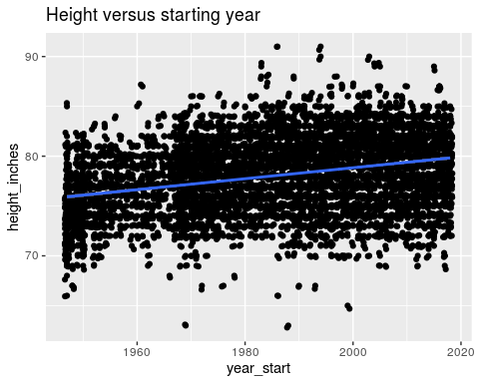

Slide 23
It does appear tha there has been an increase in the range of heights over the years. ## Question 8 3D plot of height versus weight versus year, colored by position
plot_ly(BBall, x=~height_inches,y=~weight,z=~year_start,color=~position,size=1) %>% add_markers %>% layout(scene=list(xaxis=list(title="Height"),yaxis=list(title="Weight"),zaxis=list(title="Start Year")))
## Warning: Ignoring 6 observations

Slide 24
Question 9
Colored by staying power (years played)
BBall %>% ggplot(aes(position)) + geom_bar(aes(fill=staying)) + ggtitle("Distribution of staying power (years played), by position")

Slide 25
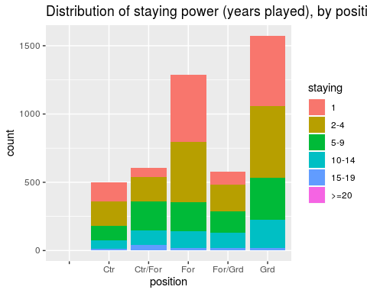

Slide 26
The Forwards and Guards are most likely to only play for one year.

Slide 27
Question 10
Test the claim that the distribution of income increases as the education level rises.
education %>% ggplot(aes(x=Educ,y=log_income)) + geom_boxplot() + ggtitle("Distribution of log income, grouped by years of education")

Slide 28
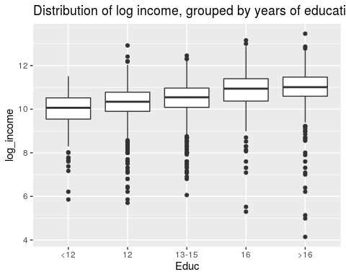

Slide 29
Visualy, it doea appear that the distribution of incomes increases with each successive group.

